Slide 1
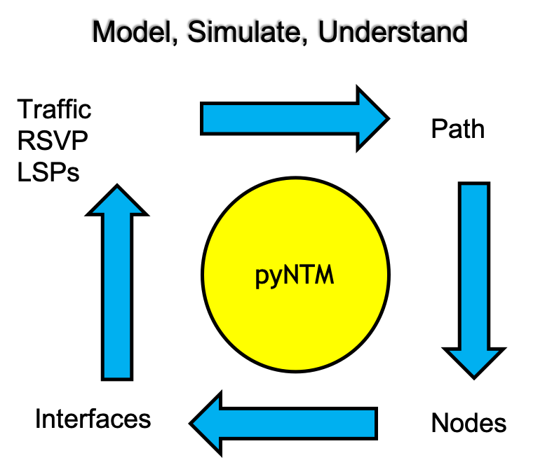
pyNTM Training Module 2 – getting started
Network Traffic Modeler in Python3

Slide 2
Versioning
Training v1.0
pyNTM v1.5

Slide 3
Course topics
Use python3!
What is pyNTM?
Get pyNTM
LIVE DEMO - setting up a virtual environment (if wanted/needed)
About the Model file
Setting up for the Exercises
Converging the Model
Visualization (beta)

Slide 4
Course topics (continued)
Live Exercise 1: shortest path(s)
Examine IGP topology for the shortest path(s) between two Nodes
Live Exercise 2: Failing an Interface
Failing an Interface and assessing impact on Interface utilization
Live Exercise 3: Finding traffic Demands on an Interface
Determine which Demands are driving Interface utilization
Live Exercise 4: Finding the path(s) of a specific Demand
Determine the ECMP path(s) a Demand takes through the IGP topology
Live Exercise 5: Unfailing an Interface

Slide 5
What is pyNTM?
pyNTM is the Network Traffic Modeler in python3
It is a modeling and simulation engine
It provides capability to define/modify a network topology
It provides capability to apply a traffic matrix to that topology to get simulation results
It does NOT provide a traffic matrix for your network
The user will have to create the traffic matrices for their network
Network modeling aside, in order to understand your network, it is imperative to understand the traffic matrix

Slide 6
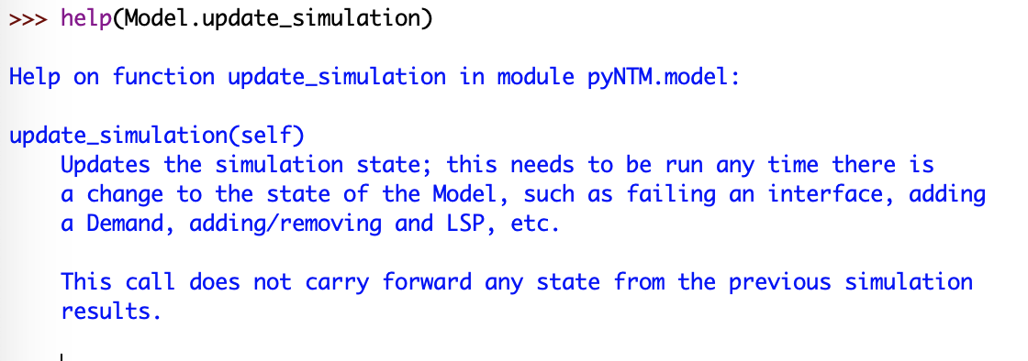
Getting and using pyNTM
Get pyNTM – 2 options
PyPI – PYthon Package Index
From OS CLI: pip3 install pyNTM
Download the repository from Github
https://github.com/tim-fiola/network_traffic_modeler_py3
pip3 installs current master branch
Dev branch has additional features under development
Documentation
https://pyntm.readthedocs.io/en/latest/index.html
Docstrings are also available via help call for the def

Slide 7
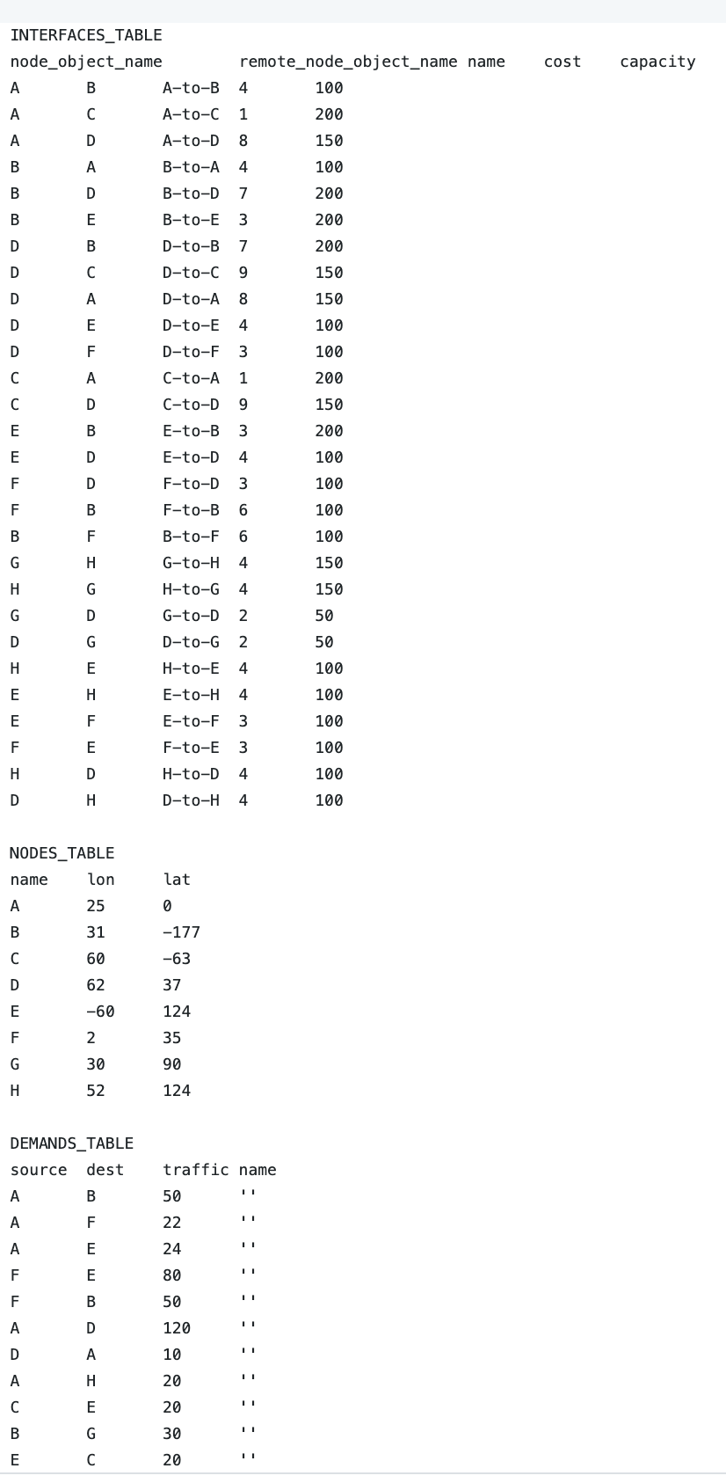
About the model file
Tab separated file that describes
Interfaces
Nodes
Nodes can be inferred from their interface objects
The NODES_TABLE is present in the event that
You want to add other attributes for a Node (latitude, longitude)
You want to load an orphan node to your model (a Node that has no interfaces)
Demands
RSVP LSPs (if applicable)
Use the example model file as a template for making a model of your network

Slide 8
Exercise setup

Slide 9
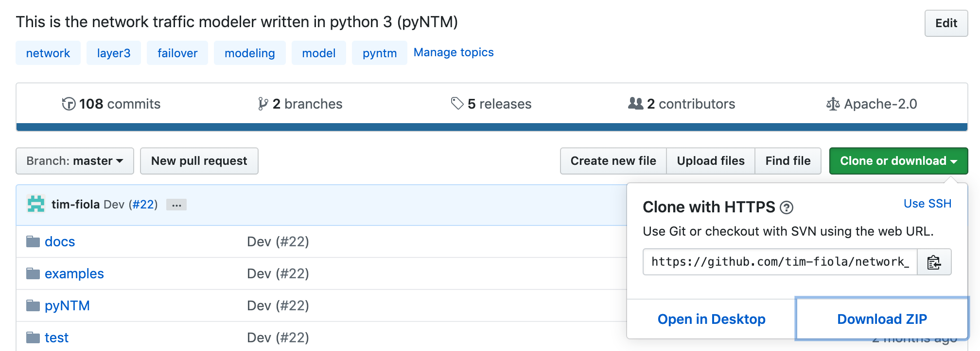
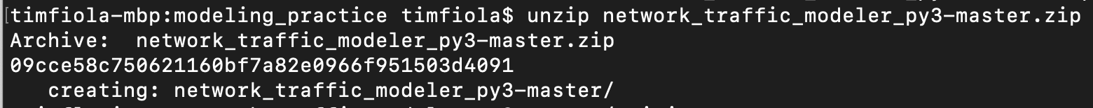
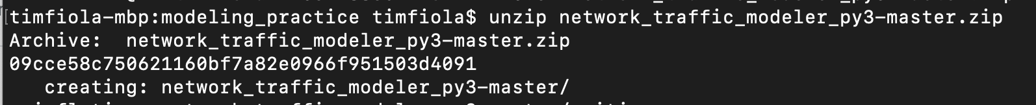
Copy the repository zip file to a practice directory and unzip it
Copying the repository will allow you to use some of the additional tools to improve your user experience
Visualization
Simple user interface

Slide 10
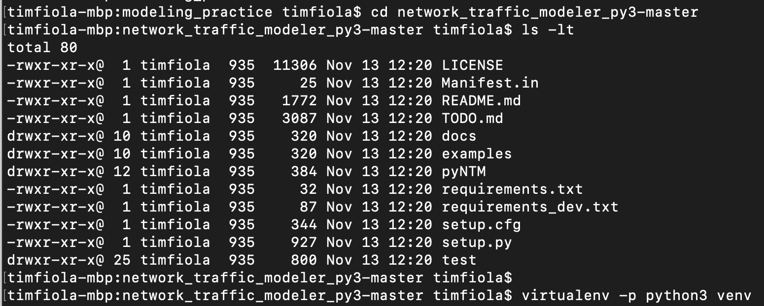
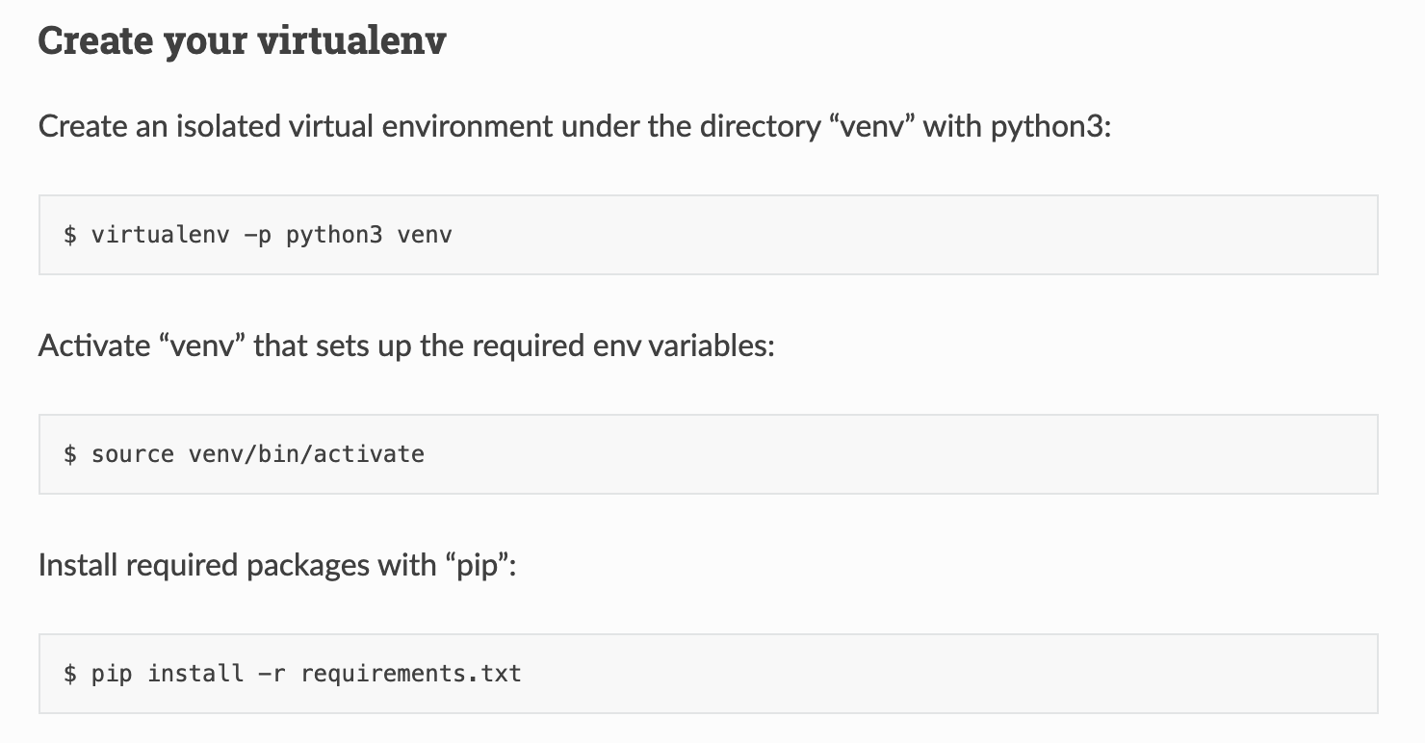
Set up your virtual environment (optional)
A virtual environment provides an isolated environment and ensures no interference from existing installations and/or dependencies
Go into the archive directory
Look for requirements.txt
Follow directions below to create the virtual environment
Example is to the right →

Slide 11
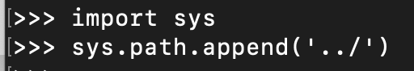
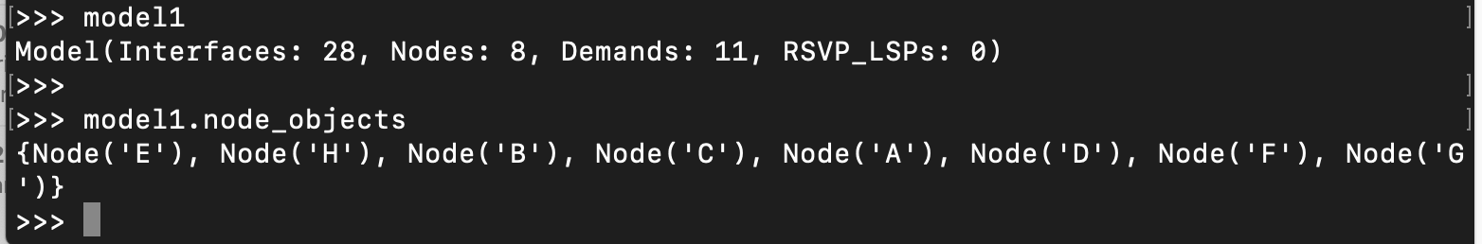
Let’s get started!
Switch to the examples directory in the repository
Start python3
Append parent directory to your sys path
Allows imports from folders in the parent
Import the Model object
Load Model from data file
sample_network_model_file.csv has Interfaces, Nodes, and Demands
IGP only
no RSVP LSPs in the file
Observe node objects

Slide 12
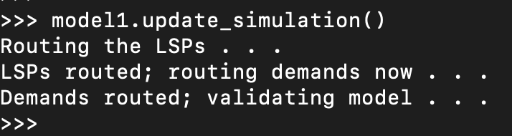
Converging the model
In order to route the traffic across the network topology to get modeling data, the Model must be explicitly converged
A Model should be converged after it is loaded from a file
A Model should be re-converged if you make any change to the topology
Failing an Interface or Node
Un-failing an Interface or Node
New Node, Interface, traffic Demand, RSVP LSP, SRLG etc
Any change, otherwise, to the topology or traffic matrix
Use the update_simulation() call on the Model object to converge the model
This will converge the model and run some internal validation checks

Slide 13
Converging the model (continued)
Failing to run update_simulation() is likely to result in incorrect modeling and/or Model exceptions
The time it takes to converge the model depends on
How many RSVP LSPs are present
Size of topology
Amount of entries in traffic matrix
The amount of processing/memory available on the machine
It may take a couple minutes or more for the model to converge for very large model files

Slide 14
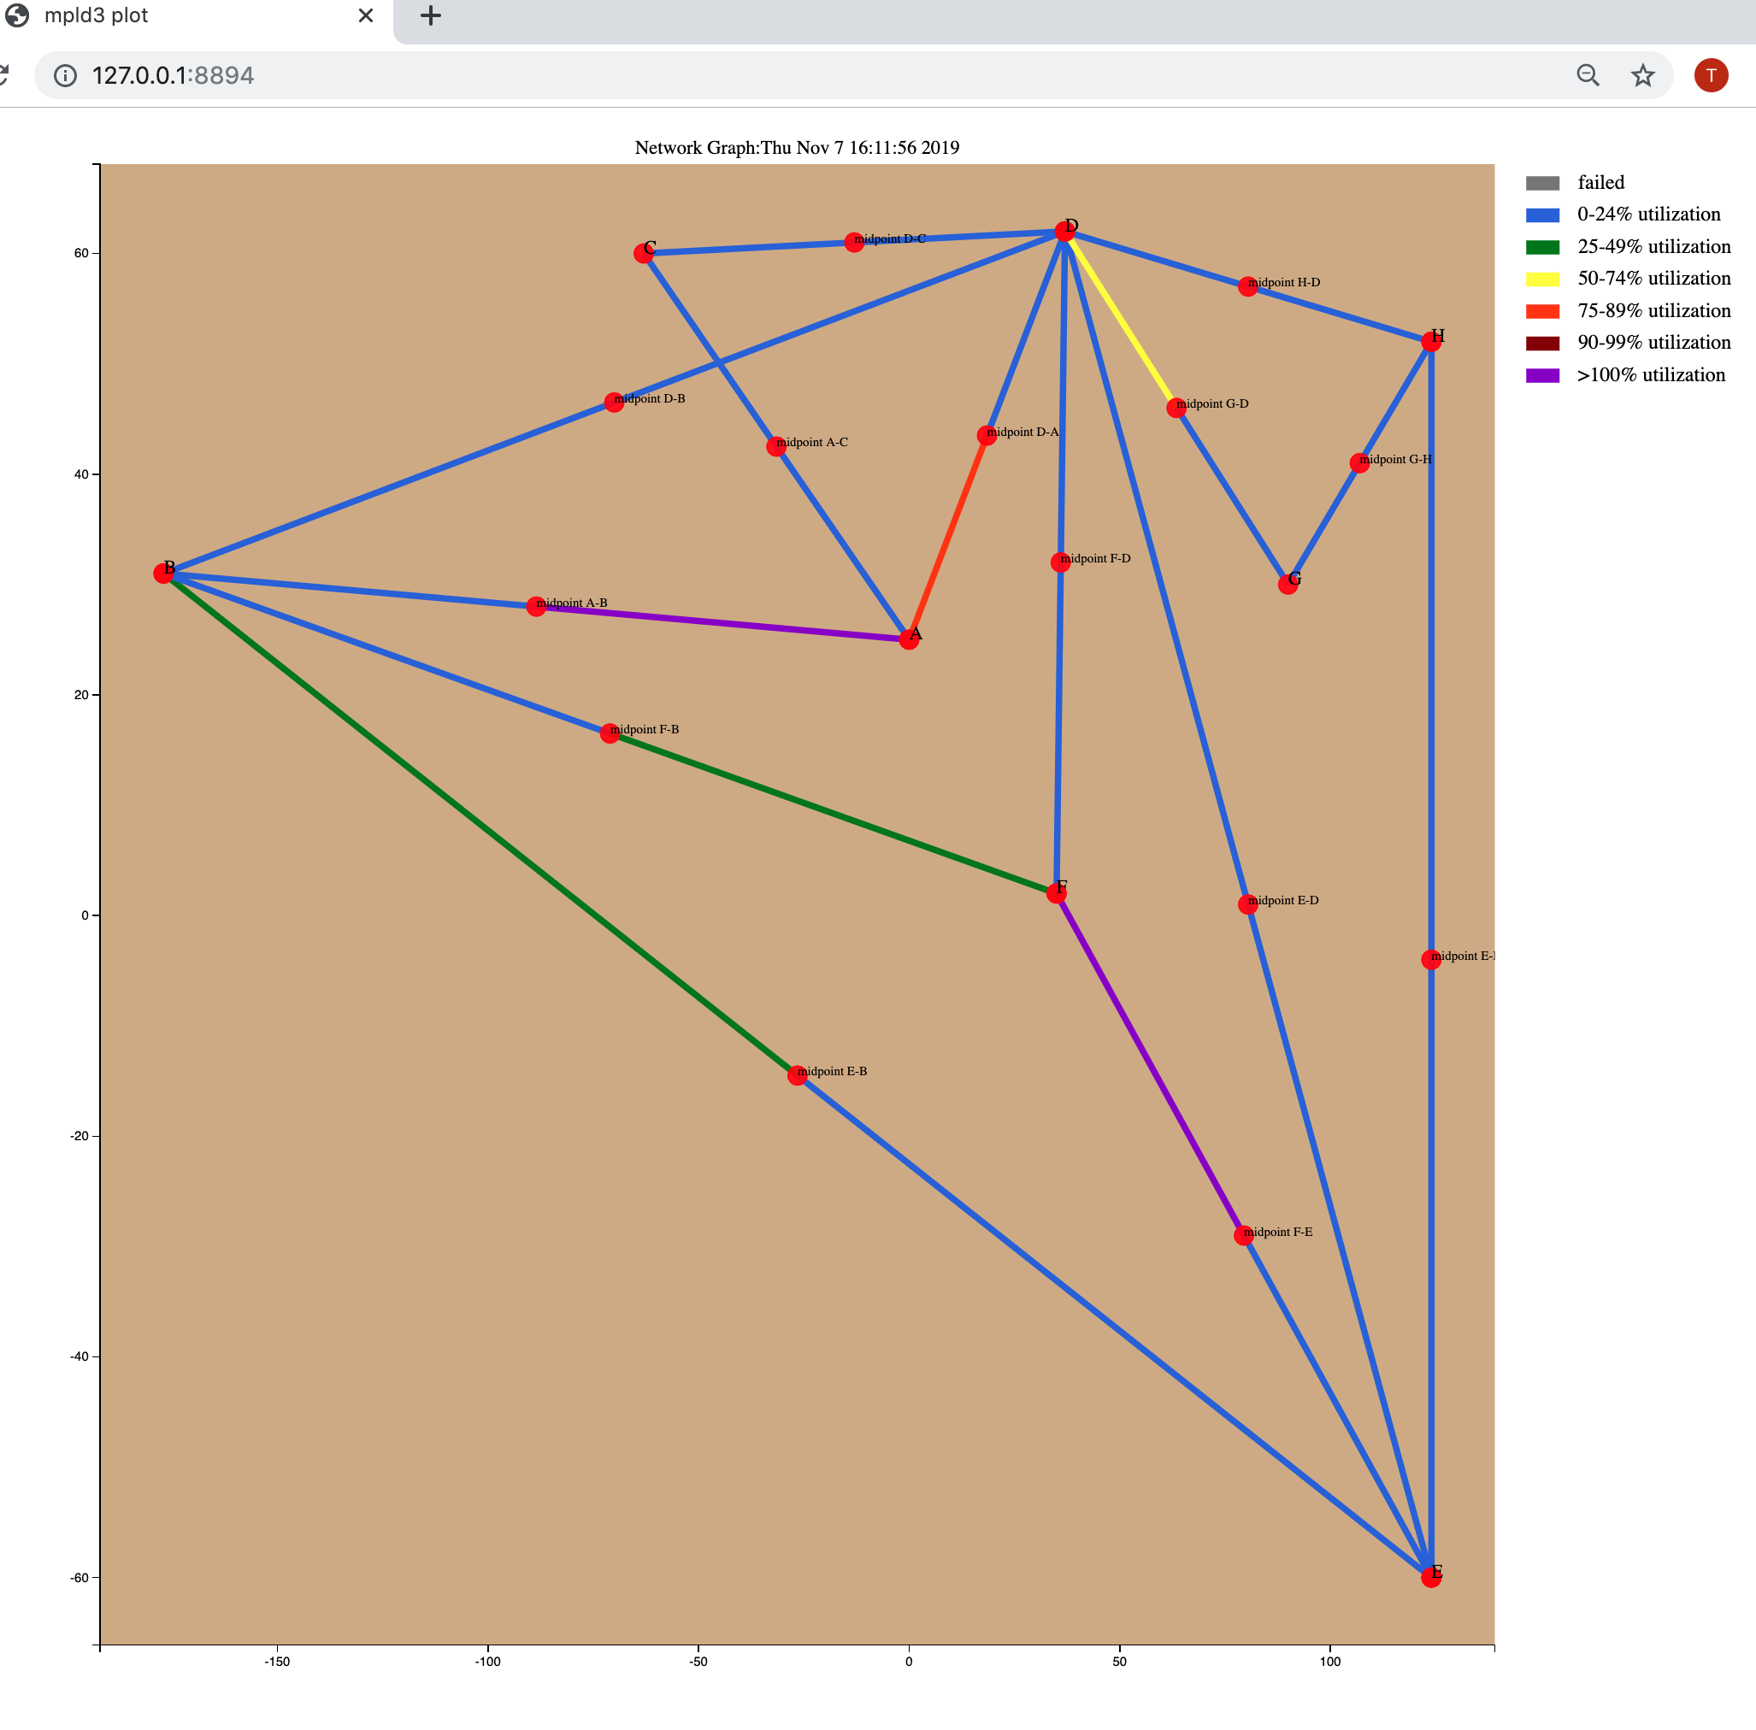
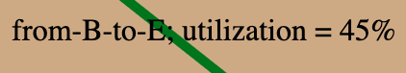
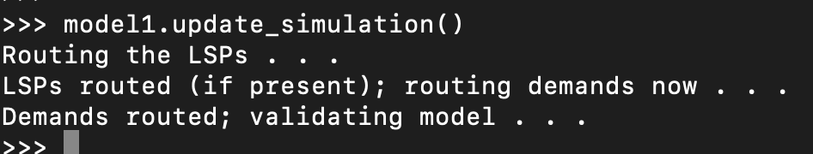
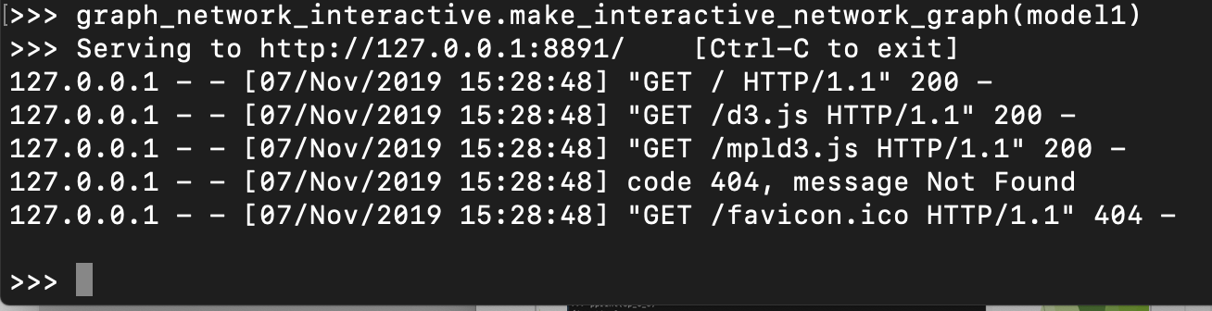
Visualization (beta) - optional
Requires full repository download from GitHub or extract the module
Easy access via the virtual environment setup from earlier in this guide
Reference the Exercise setup earlier in this presentation for full instructions to set up the environment to use the repository
Make sure the model is converged!
model1.update_simulation() ← model1 is the Model object
graph_network_interactive.make_interactive_network_graph call
Takes Model object as argument
uses mpld3 python package under the covers
Produces interactive graph in browser with tool tips, an interactive legend, and draggable Nodes and Interface endpoints for easier viewing
Uses a Node’s lat/lon (y,x) attributes to position Node on layout
The Interface from B to A is 0-24% utilized
Interactive legend
Tooltips appear when hovering over interfaces and nodes
All nodes and circuit midpoints are movable
The Interface from A to B is over 100%

Slide 15
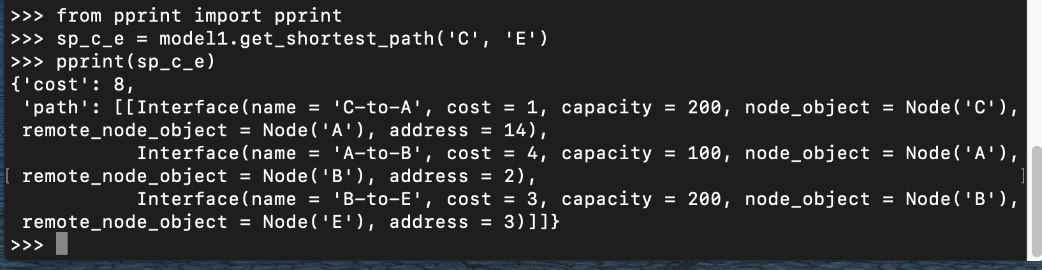
Live Exercise 1: Shortest path(s)
Observe shortest path(s)
If there are multiple shortest paths, the ‘path’ value list will have multiple lists, each one a unique path
Each path list in the ‘path’ value list is an (ordered) list of Interfaces from source to destination
In the example below, the shortest path from Node C to Node E
has a total IGP cost of 8
has a single shortest path
egresses 3 Interfaces, in order, from source to destination:
Node C to Node A
Node A to Node B
Node B to Node E

Slide 16
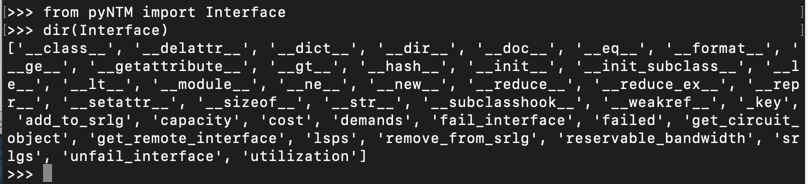
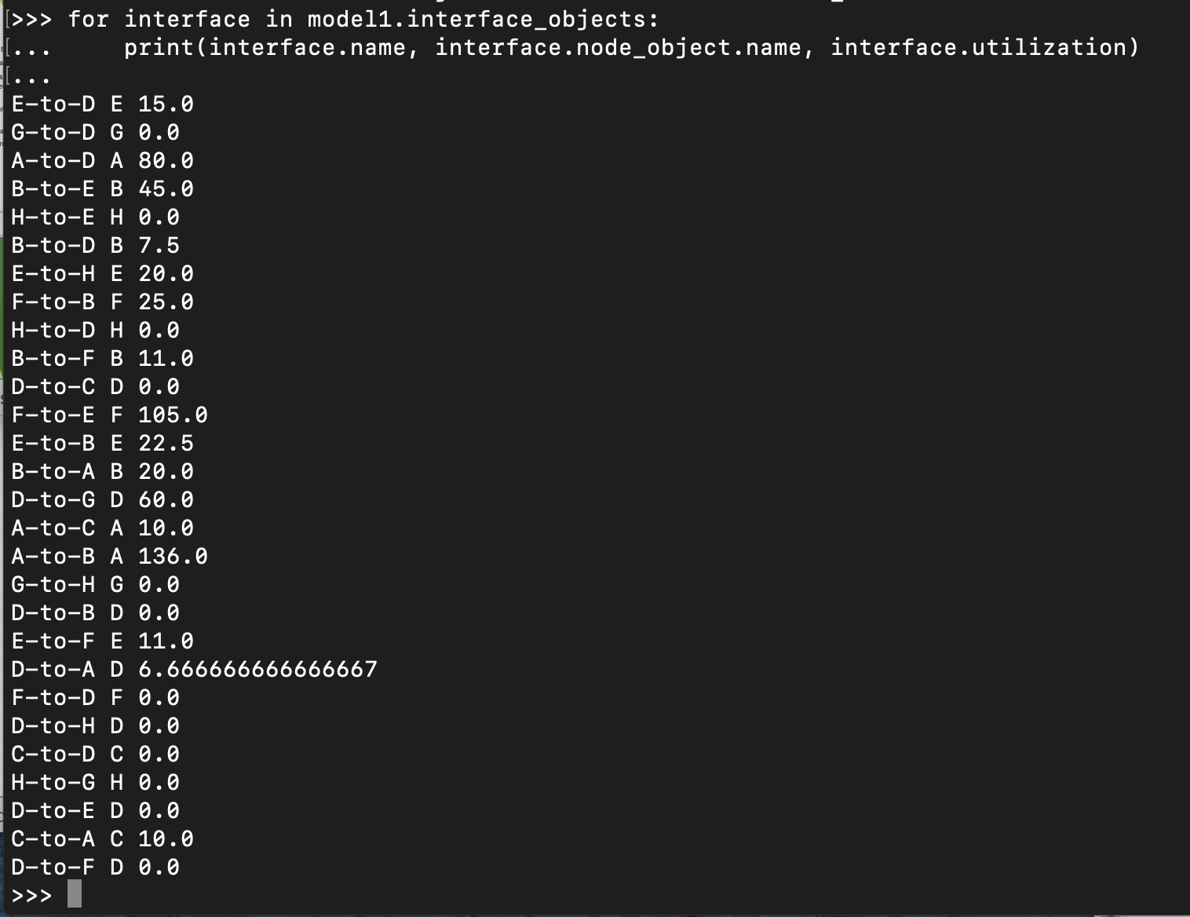
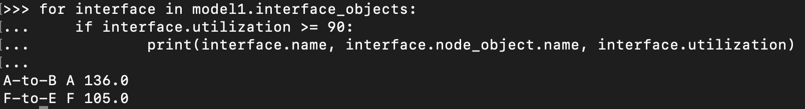
A quick look at interface utilization
Interface objects have several attributes and methods
Quickly find the utilization of each interface with a simple for loop!
Interface.name
Name of the Interface
Interface.node_object.name
Name of the Node object that the Interface resides on
Interface.utilization
% traffic utilization
Easily add qualifiers to find Interfaces with specific qualifiers
For example, Interfaces with utilization 90% or above:

Slide 17
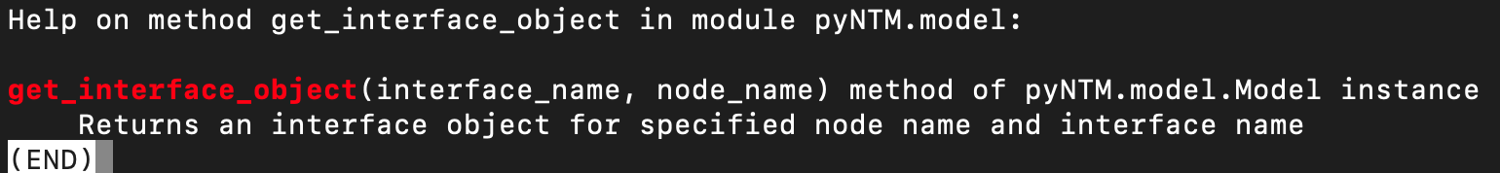
Live Exercise 2: Failing an Interface/Circuit
Circuit objects have two member Interface objects
One of the Interfaces fails, the Circuit and the remote Interface objects also fail
Step 1: get Interface object
There are a few ways to do this
Technique 1: get interface via get_interface_object Model call
Need to know Node name and Interface name

Slide 18
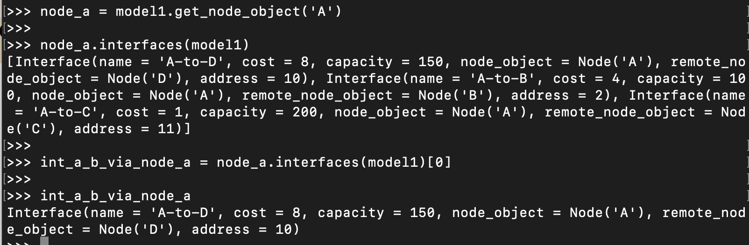
Step 1 (continued) – get Interface Object (technique 2)
Get an interface object from a Node’s interface list
Only need to know Node name
Get the Node object
List the Node’s Interfaces
Select the Interface from the list

Slide 19
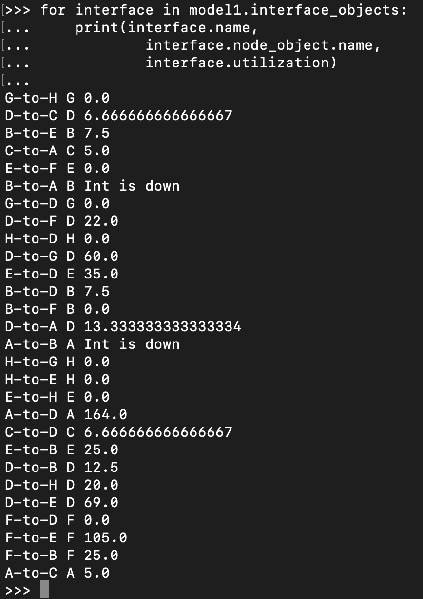
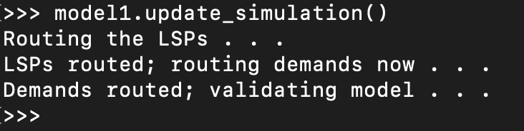
Live Exercise 2: Failing an Interface/Circuit (continued)
Step 2: fail the interface object
Uses Interface fail_interface method
Step 3: update the simulation
Step 4: check interface utilization

Slide 20
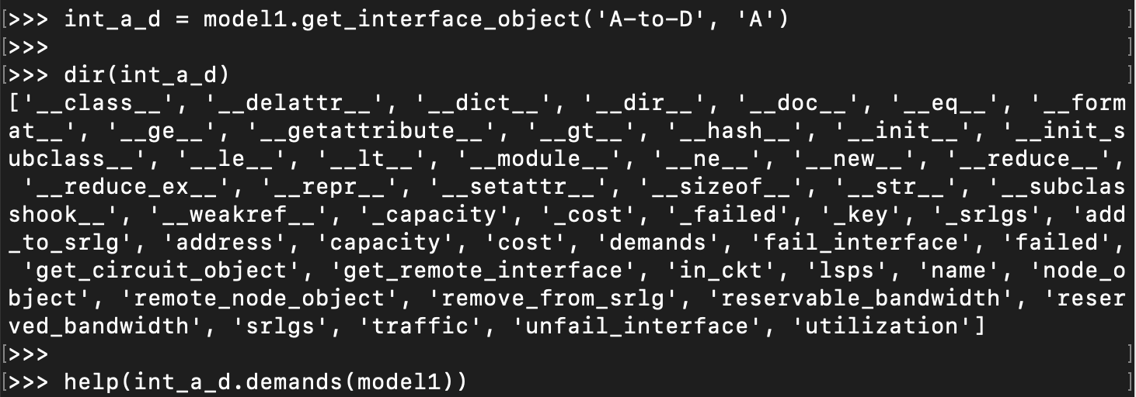
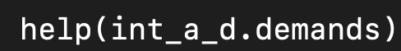
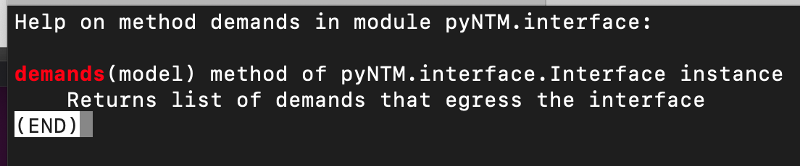
Live Exercise 3: Finding traffic demands on an interface
Looking at the interface utilizations from Exercise 2, the interface from Node A to Node D shows 164% utilized
Let’s see which Demands (traffic) is driving that utilization
Use the Interface demands method

Slide 21
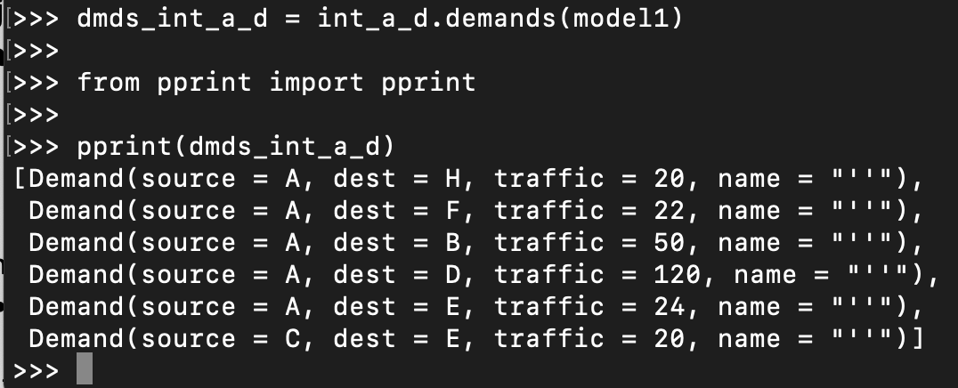
Live Exercise 3: Finding traffic demands on an interface (continued)
There are 6 demands on the Interface

Slide 22
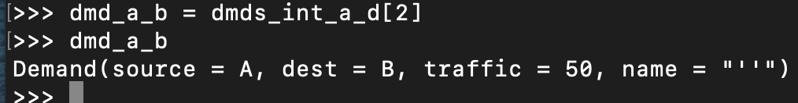
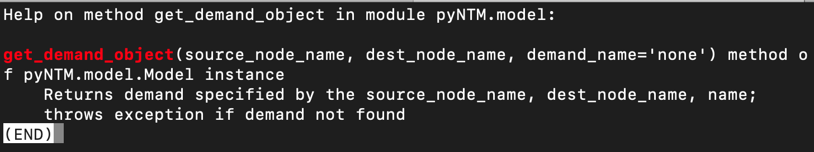
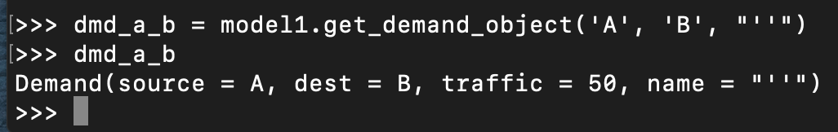
Live Exercise 4: Finding Demand path(s) in an IGP network
From our Demand results in Exercise 3, find the path of Demand(source = A, dest = B, traffic = 50, name = "’’”)
Keep in mind that the Circuit between Nodes A and B is failed (from Exercise 2)
Get the demand object
Either by getting item 2 from dmds_int_a_d (list) (from Exercise 3)
The specific index for this demand will vary; check your own results
Or using the Model get_demand_object method

Slide 23
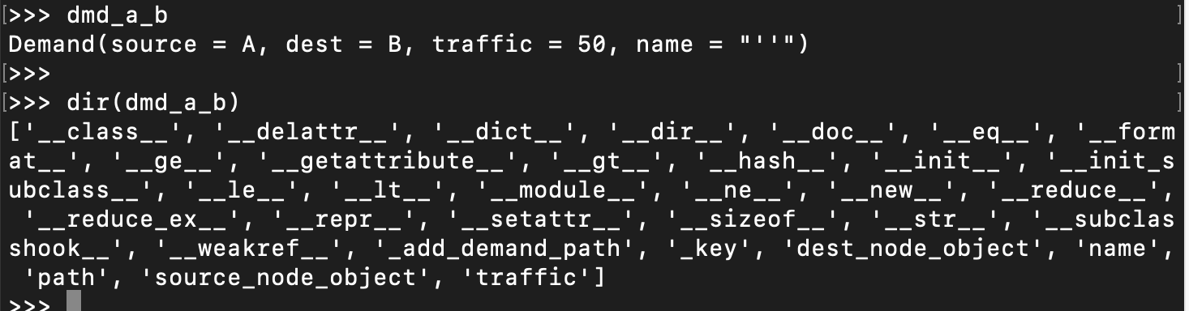
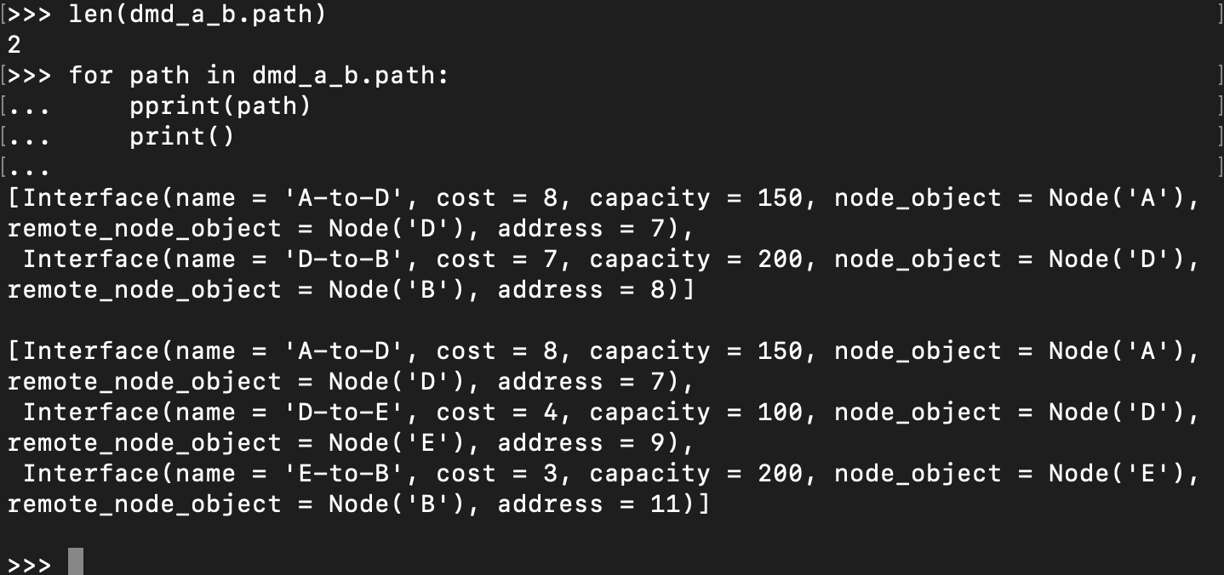
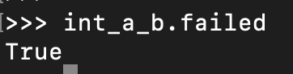
Live Exercise 4: Finding Demand path(s) in an IGP network (continued)
The demand has 2 ECMP paths
The Demand path call returns a list of lists
Each component list shows the Interfaces the Demand egresses, in order, from the source Node to the Destination Node
Keep in mind that we previously failed the Circuit between Nodes A and B

Slide 24
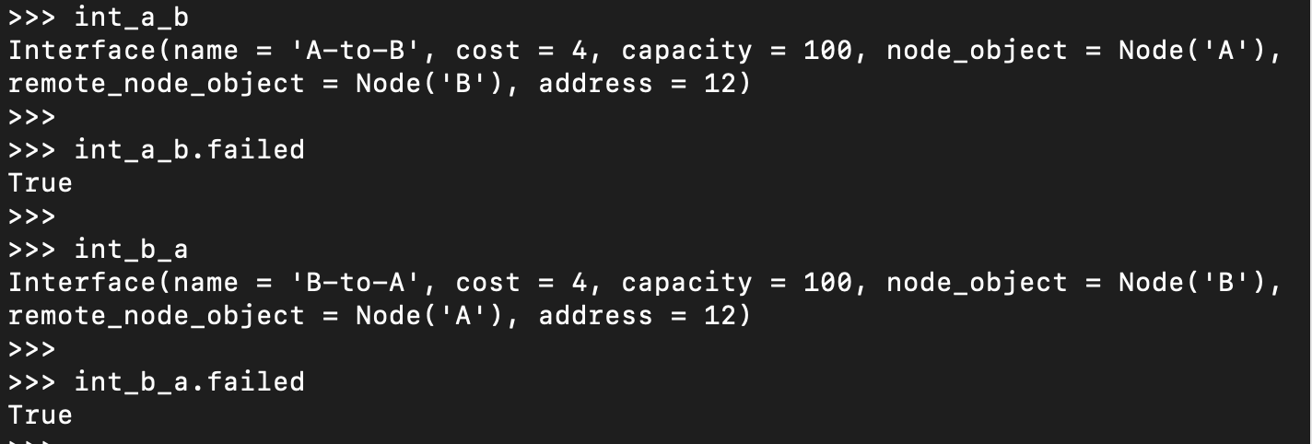
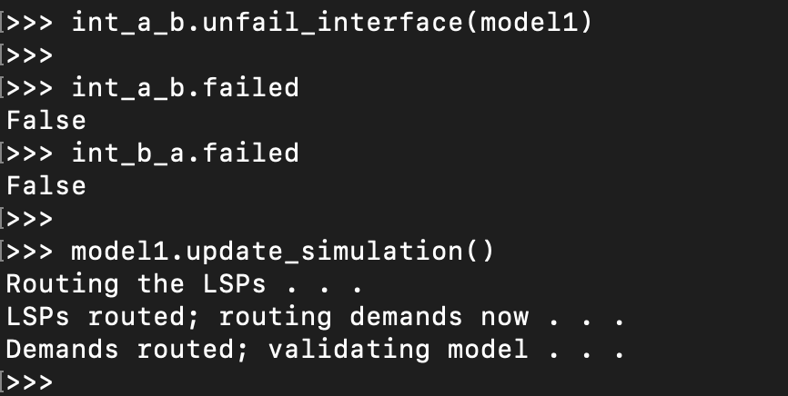
Live Exercise 5: Unfailing an Interface
Now that our failure analysis is complete, unfail the Interface on Node A facing Node B
The Interface on Node B facing Node A also unfails automatically

Slide 25
Simple User Interface tool (beta)
The Simple UI is designed to allow a user to gain insight about the network topology and how traffic transits the network
The Simple UI supports the following
Designed to allow non-coders to explore aspects of IGP topology; use cases include:
Easily see which Demands source from a specific Node
Select a Demand and see its path(s)
Select an Interface from a path
See Demands that egress an Interface
Select Interfaces above a specific utilization
Limitations
Does not support MPLS RSVP LSPs
Does *not* support modifying the topology (failing/adding Interfaces, Nodes, etc)

Slide 26
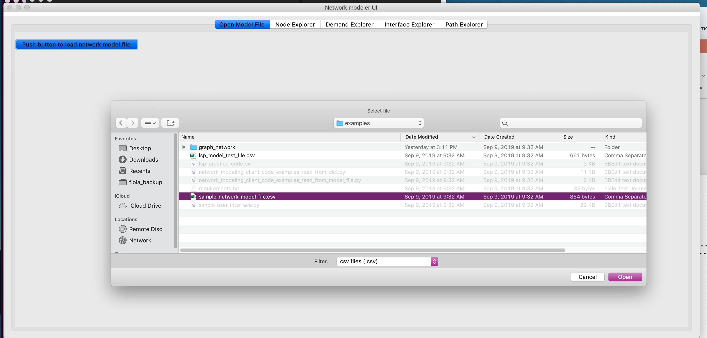
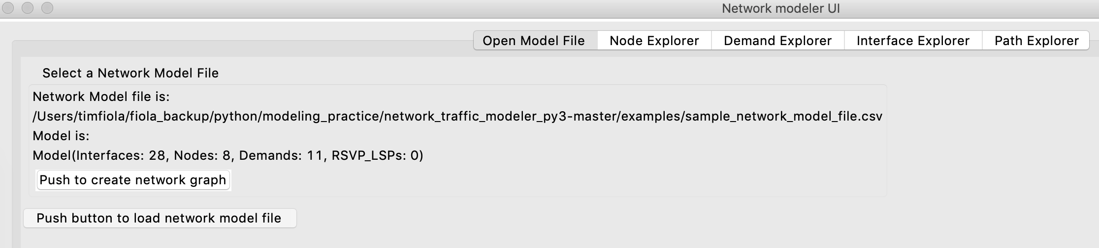
Simple UI – getting started
In examples folder in repository:
python3 simple_user_interface.py
Push button in upper right corner to open the model file
Select sample_network_model_file.csv
Create an interactive network graph in a browser by pressing the button

Slide 27
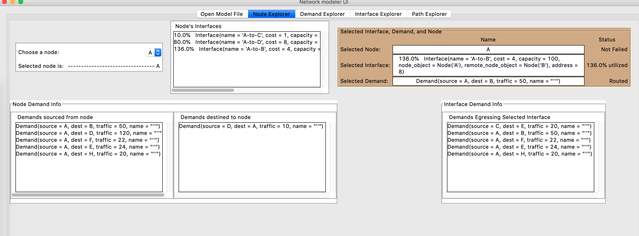
Node Explorer
Select a Node
View/select Node’s Interfaces and Interface utilization
View/select Demands (traffic) sourced from and destined to Node

Slide 28
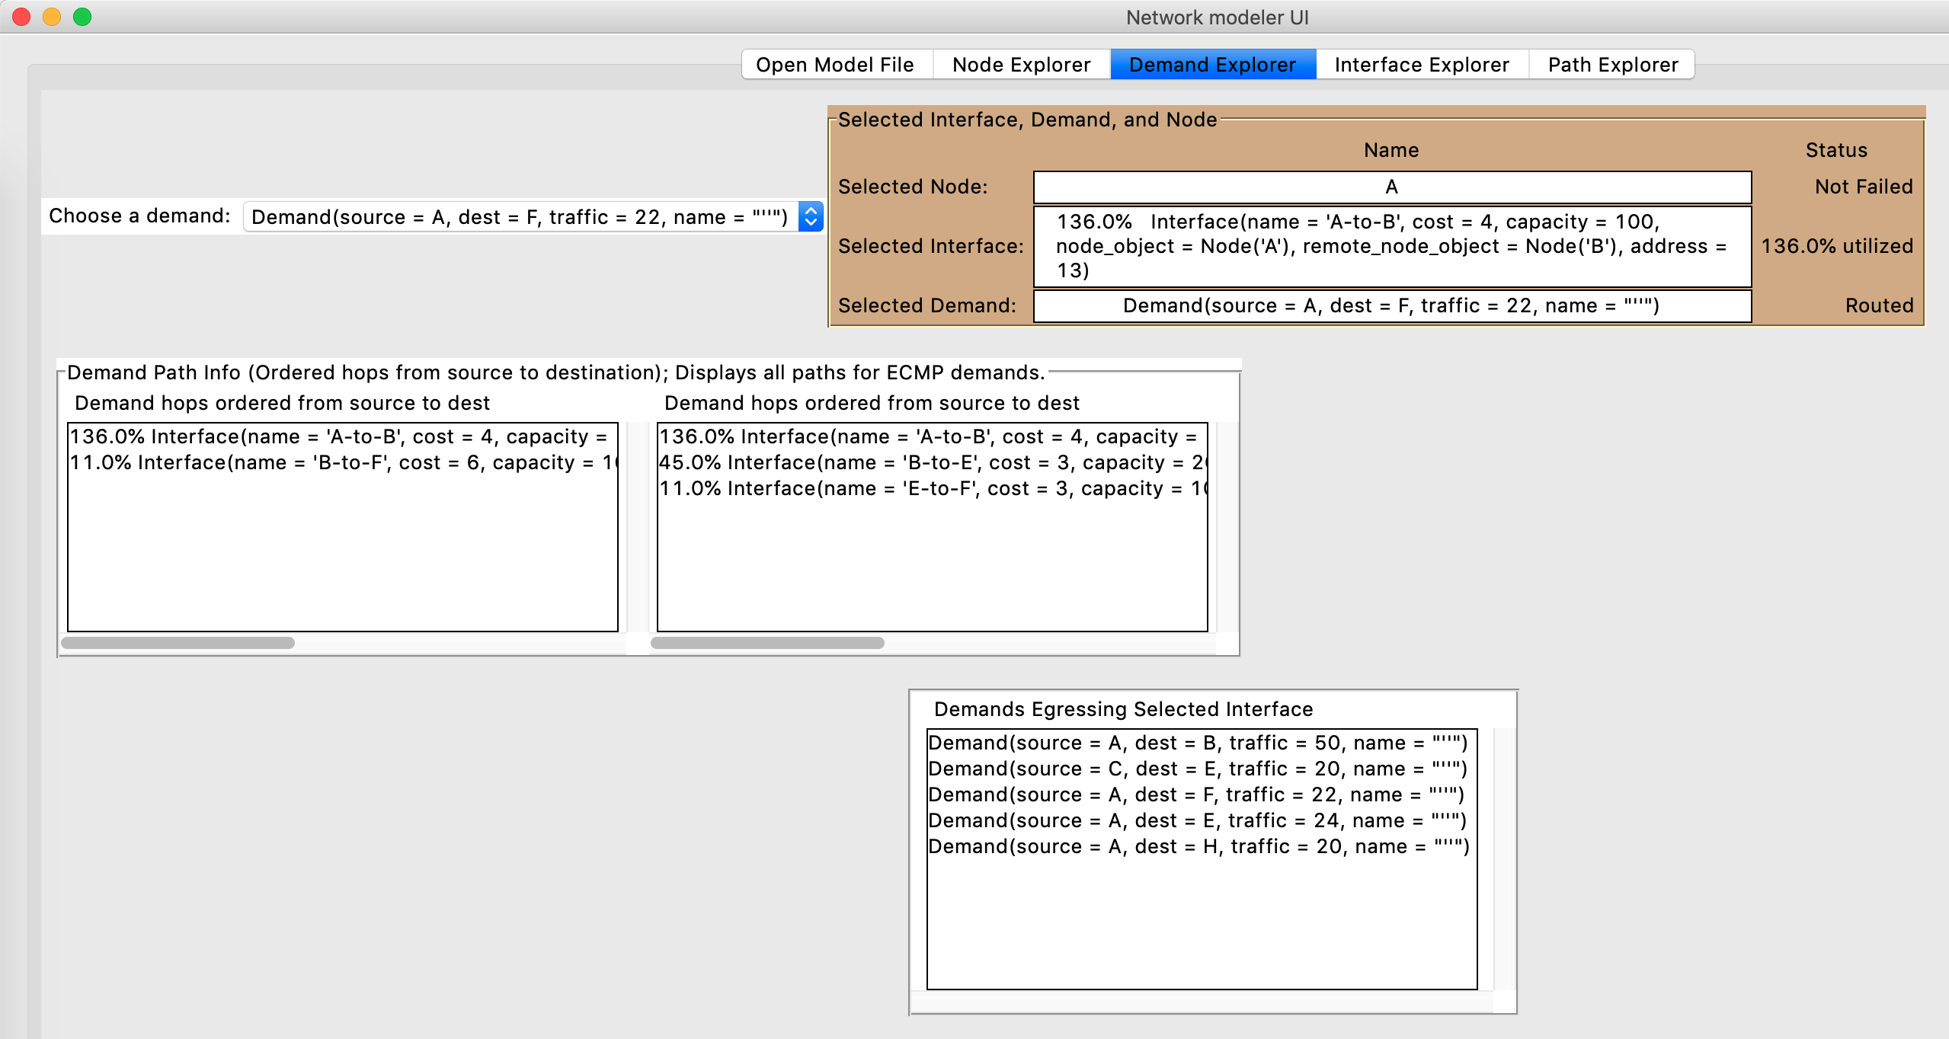
Demand Explorer
Select a Demand object
View/select Interfaces that Demand egresses from source to destination
Displays multiple paths for a demand if multiple paths exist

Slide 29
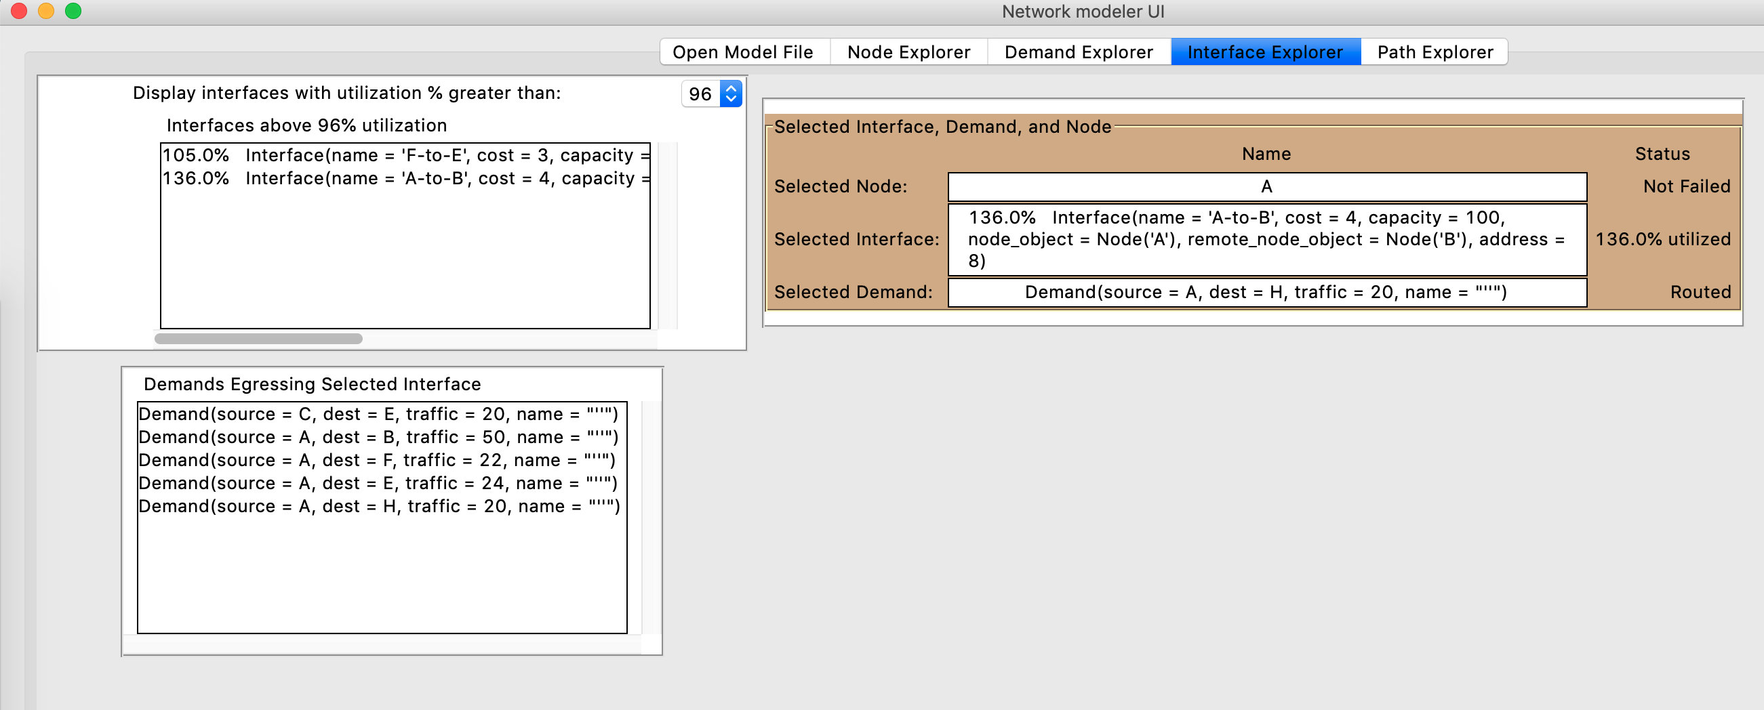
Interface Explorer
Find/Select Interfaces with utilization greater than a user-defined percentage
Find Demands (traffic) egressing the selected Interface

Slide 30
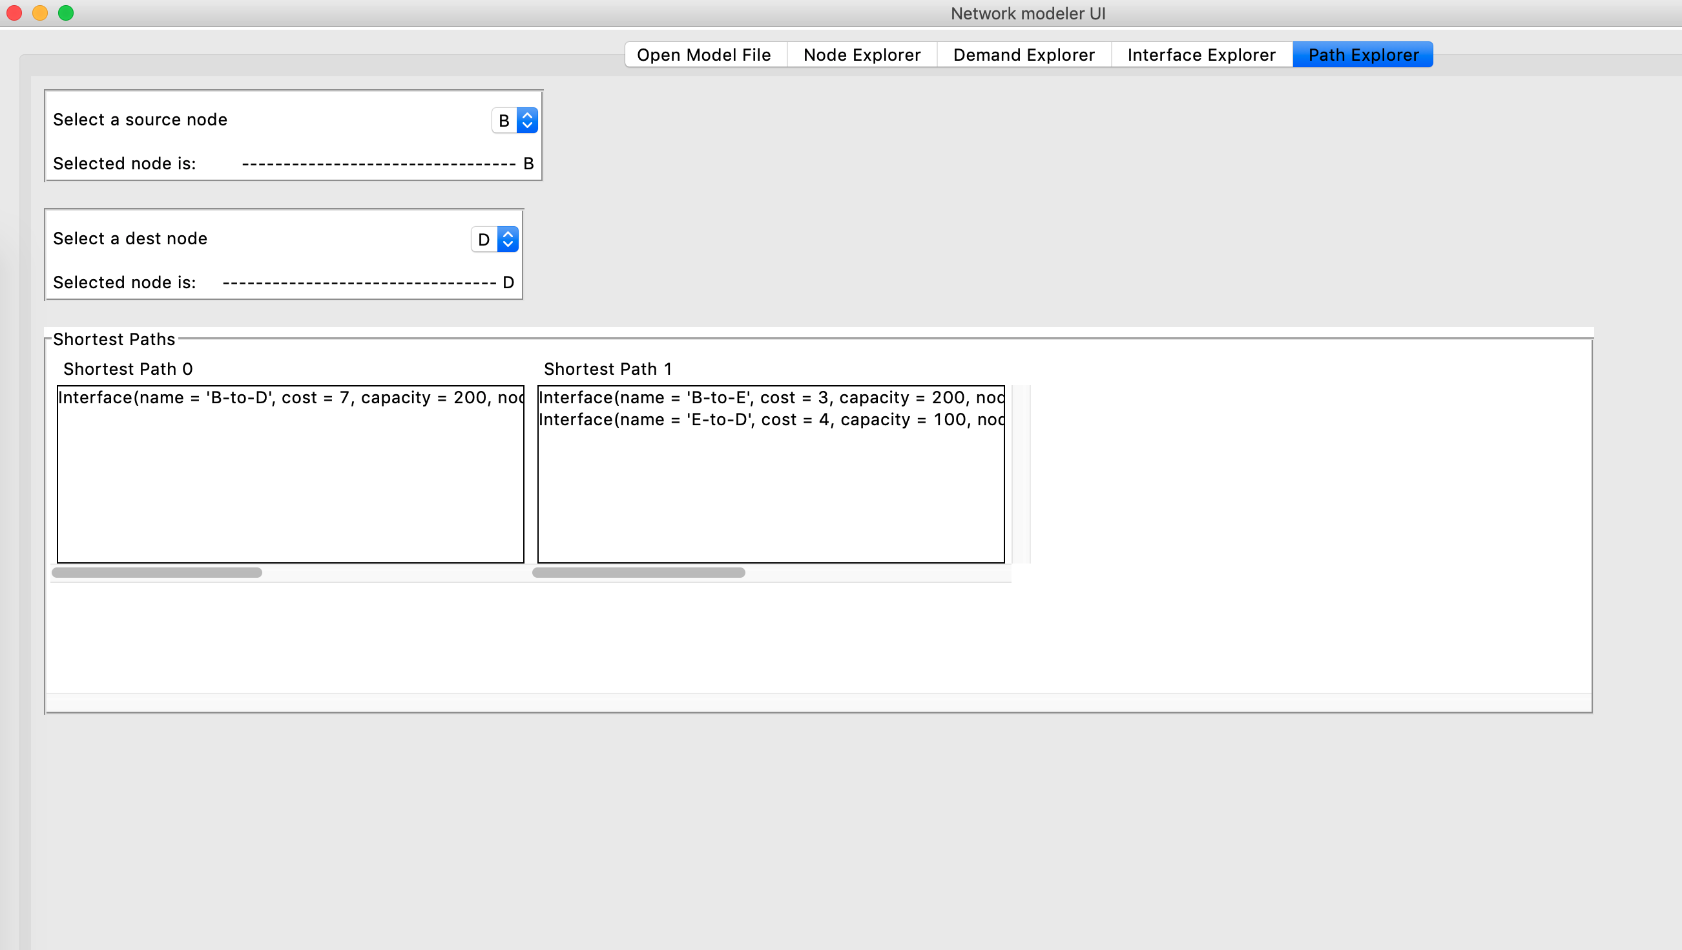
Path Explorer
Select a source and destination Node
Find all shortest paths between the 2 Nodes
View/Select the Interfaces in any shortest path

Slide 31
FIN

Slide 32
BACKUP SLIDES

Slide 33
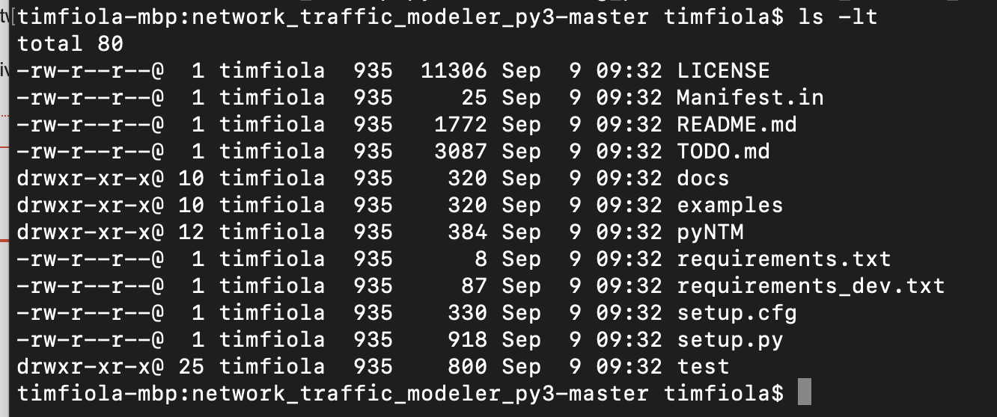
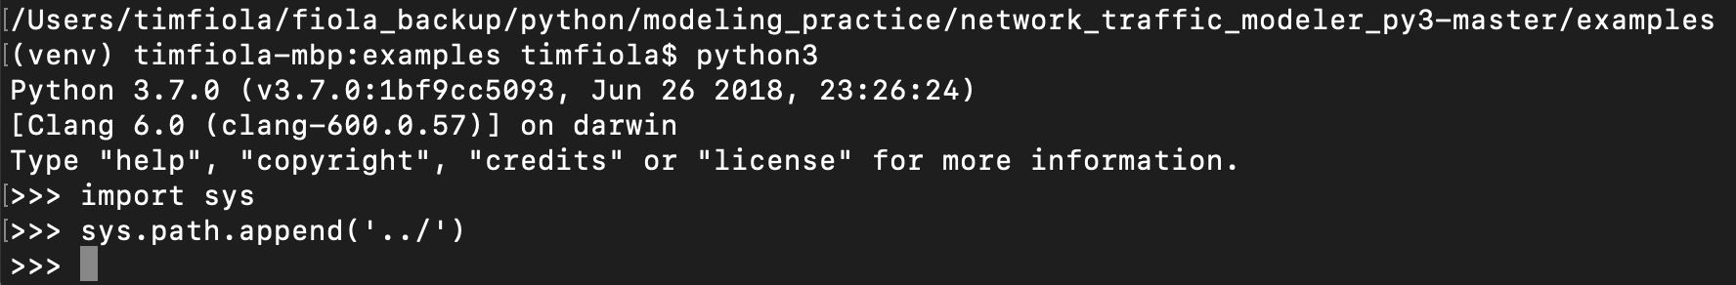
LIVE DEMO – virtual environment
Benefits of virtual environment
Isolated environment to work in
Allows easy access to pyNTM beta features if you download the archive from github
Simple user interface
Network visualization
https://pyntm.readthedocs.io/en/latest/install.html#virtualenv
Download the archive from github
Download the zip file from https://github.com/tim-fiola/network_traffic_modeler_py3
Unzip the archive
In the archive, cd to directory that contains requirements.txt (network_traffic_modeler_py3-master folder)
Follow steps to the right to start venv→ → →
You will now have a (venv) in front of your prompt
To get easy access to the beta features
Switch to the examples directory in the archive
Start python3
Append the parent directory to sys.path

Slide 34
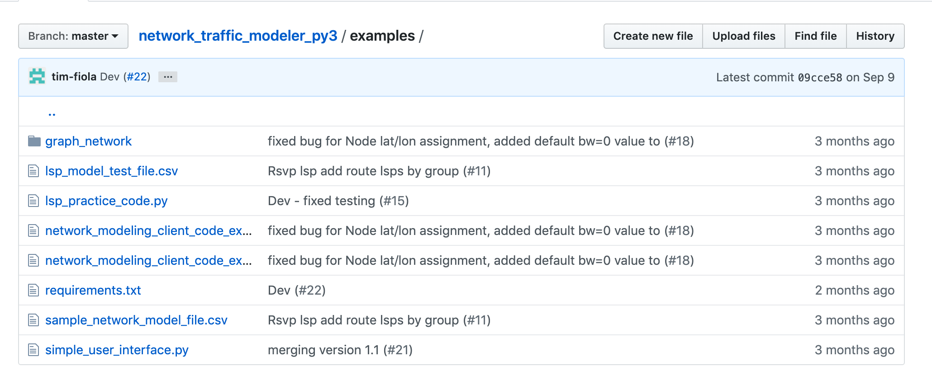
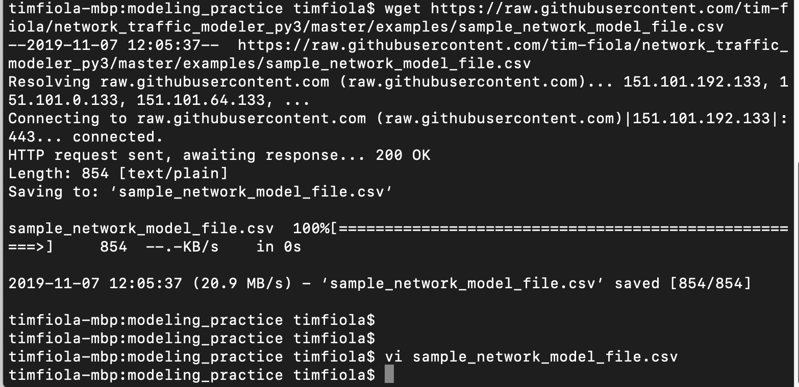
Get sample model file
Go to https://github.com/tim-fiola/network_traffic_modeler_py3/tree/master/examples
Retrieve the sample_network_model_file.csv file and put it in the local directory you want to work in
wget https://raw.githubusercontent.com/tim-fiola/network_traffic_modeler_py3/master/examples/sample_network_model_file.csv
OR Download entire repository

